Slide 1
Affinity Propagation
Affinity Propagation is a clustering algorithm used in machine learning and data analysis.
It's a partitional clustering method, which means it divides a dataset into clusters
It creates clusters by sending messages between pairs of samples until convergence
A dataset is then described using a small number of exemplars, which are identified as those most representative of other samples
The messages sent between pairs represent the suitability for one sample to be the exemplar of the other, which is updated in response to the values from other pairs.

Slide 2
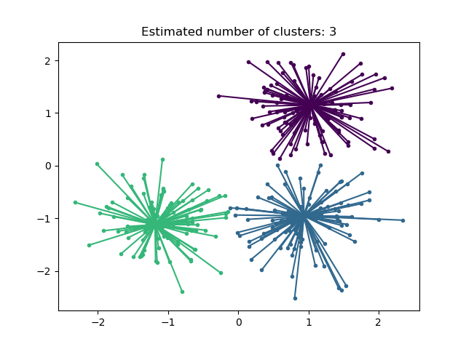
Affinity Propagation Diagram

Slide 3
Affinity Propagation can be interesting as it chooses the number of clusters based on the data provided.
For this purpose, the two important parameters are the preference, which controls how many exemplars are used, and the damping factor which damps the responsibility and availability messages to avoid numerical oscillations when updating these messages.
The main drawback of Affinity Propagation is its complexity.
Affinity Propagation most appropriate for small to medium sized datasets.

